Slide 1
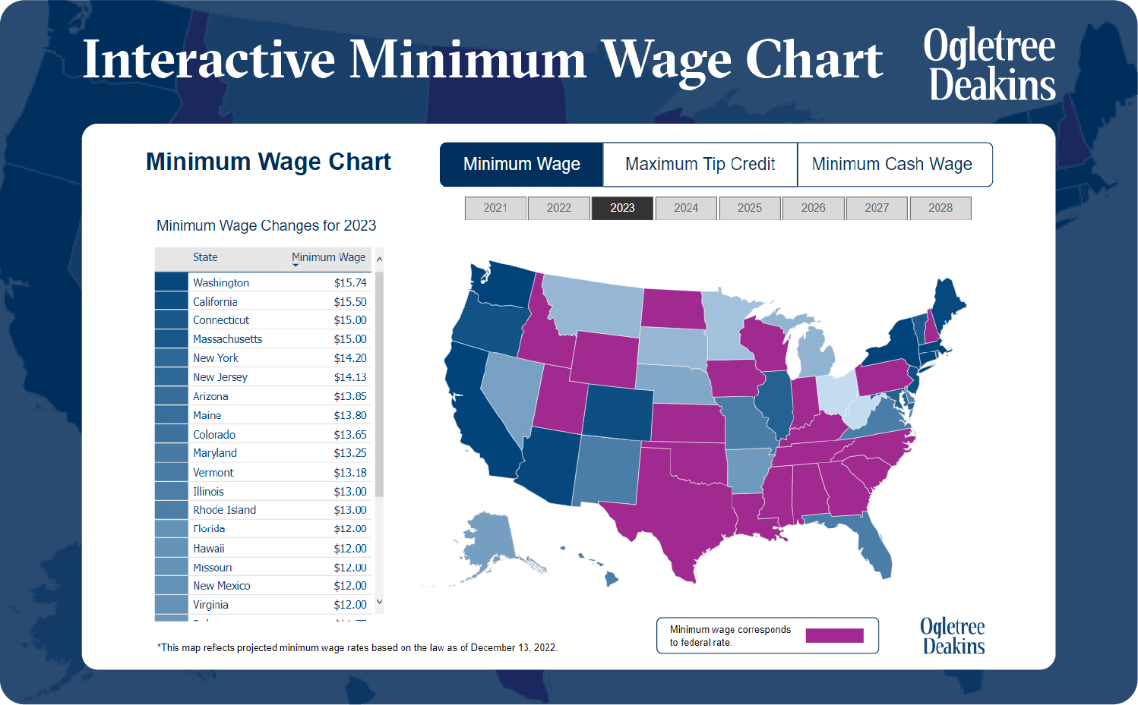

Does Raising the Minimum Wage Reduce Poverty?
A Data Visualization Project Proposal (1990–2024)
J.P ADJADEH & VICTOR ALFA

Slide 2

Research Question
Explore how changes in effective minimum wage relate to poverty rates across U.S. states (1990-2024).
Observe how unemployment influences this relationship (as a contextual variable).
Core question:
Do higher minimum wages lower poverty once unemployment effects are considered?

Slide 3
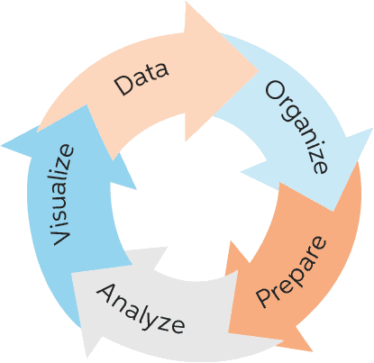
Data and Methods
Source: FRED API (Federal Reserve Economic Data) - API Available
Variables: Minimum wage (USD), Poverty rate (%), Unemployment (%).
Tools: R (fredr, tidyverse, ggplot2).
Techniques from class: scatterplots + regression lines, density plots, boxplots, 3-D surface plots, time-series visuals.
Visualization goal: use multiple chart types to reveal trends, relationships, and trade-offs.

Slide 4
Expected Outcome
Demonstrates how data visualization techniques from class can be applied to real policy questions.
Uses R graphics, ggplot2, and the Grammar of Graphics to explore relationships, not just report numbers.
Reinforces lessons on graphical perception, design effectiveness, and storytelling (Munzner 2014; Cairo 2012).
Outcome: a visual narrative that communicates how economic policy affects social welfare, following best practices in ethical, accurate, and reproducible visualization.

Slide 5
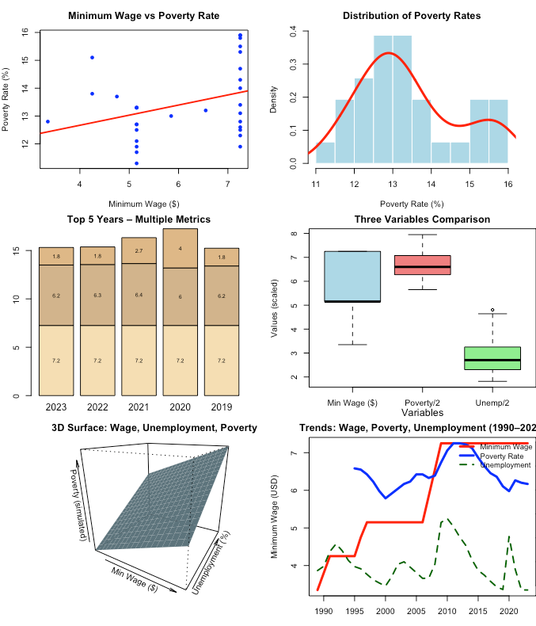
Sample Visuals
These charts are prototypes built using class coding exercises (Murrell 2016; Wickham 2016; Yau 2024).

Slide 6


